Slide 1

Molecular Communication
Model-Based Absorbing Receiver Design including
Signal Reception and Optimization.
BT_S24
Shaili Gandhi (012)
Manav Vagrecha (022)
Devam Shah (044)
Under the Guidance of Prof. Dhaval Patel, Mr. Brijesh Soni and Mr. Sagar Kavaiya

Slide 2
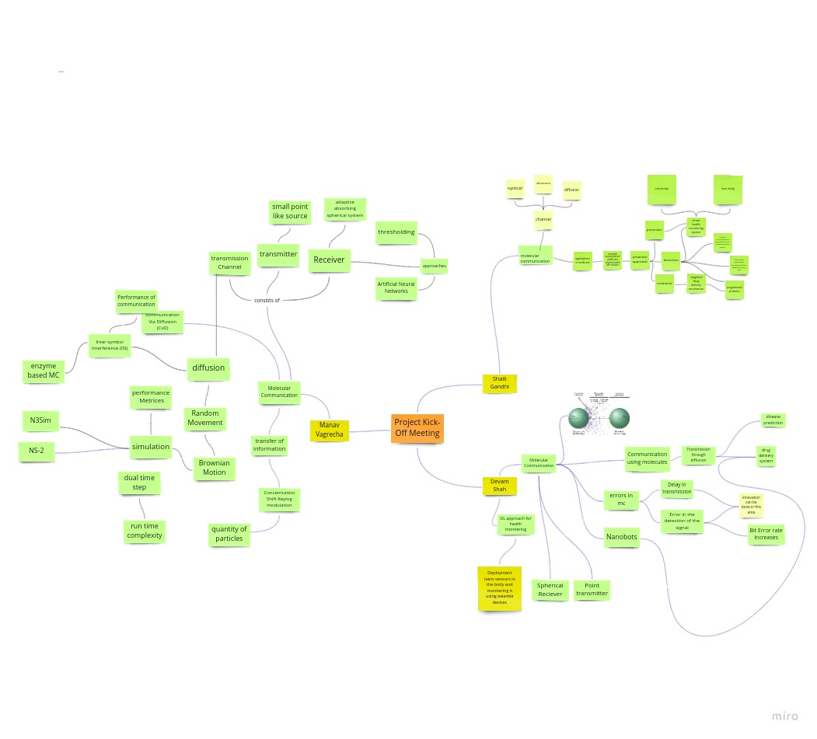
Frame 1 - Whole

Slide 3
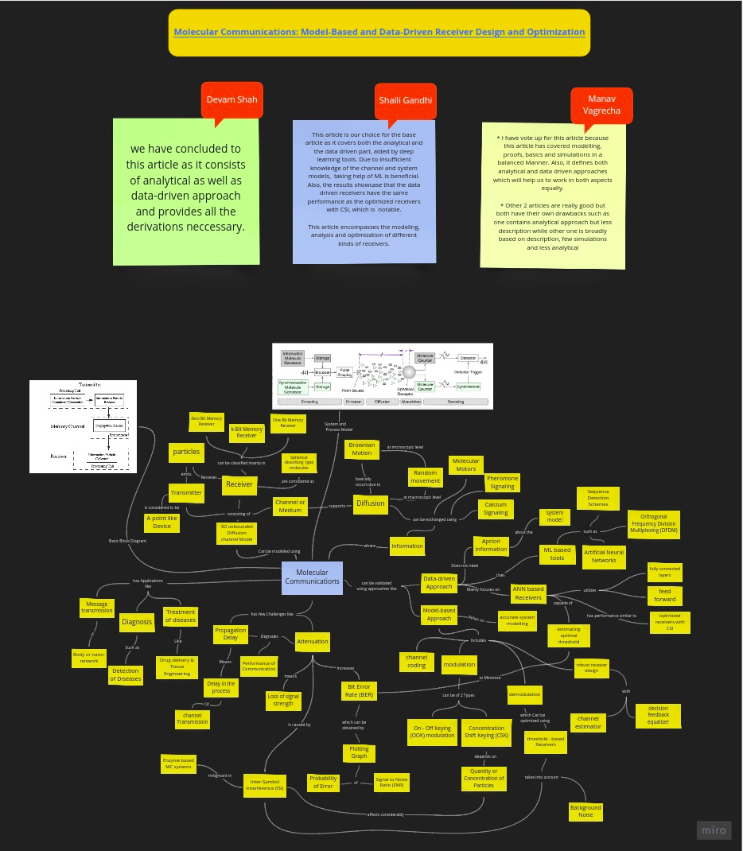
Frame 2 - Whole

Slide 4
Frame 2 - Part A

Slide 5
Frame 2 - Part B

Slide 6
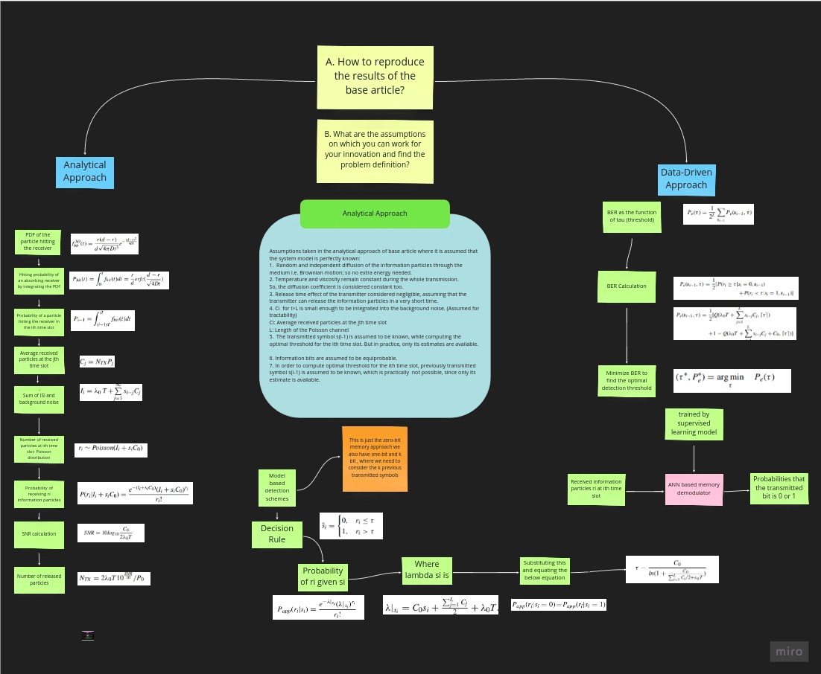
Hypothesis
Frame 3 - Whole

Slide 7
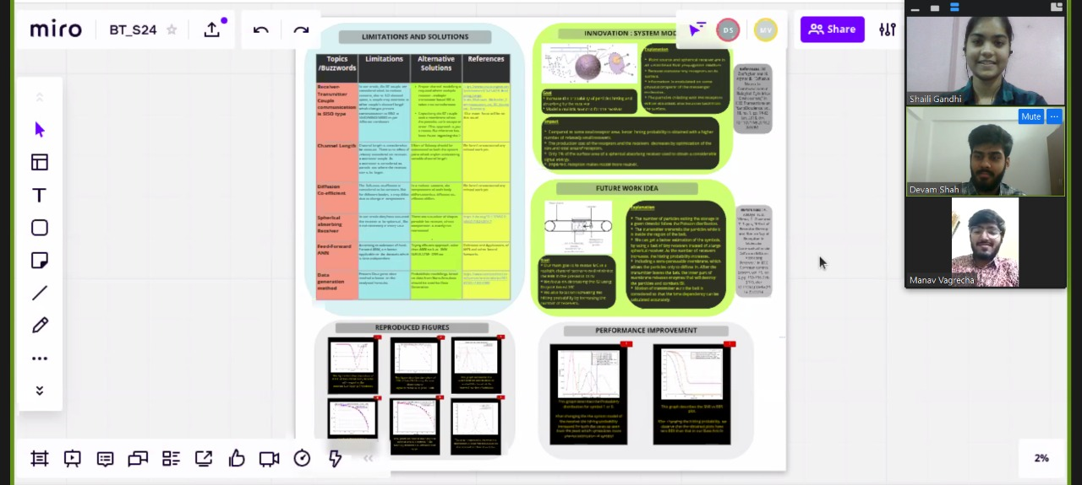
Frame 4 - Best Frame

Slide 8
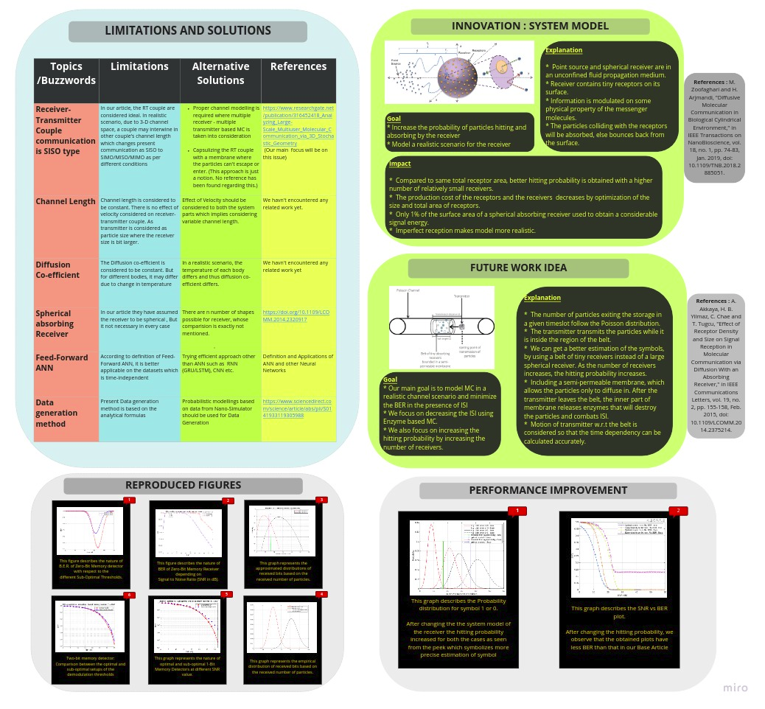
Frame 4 - Whole

Slide 9
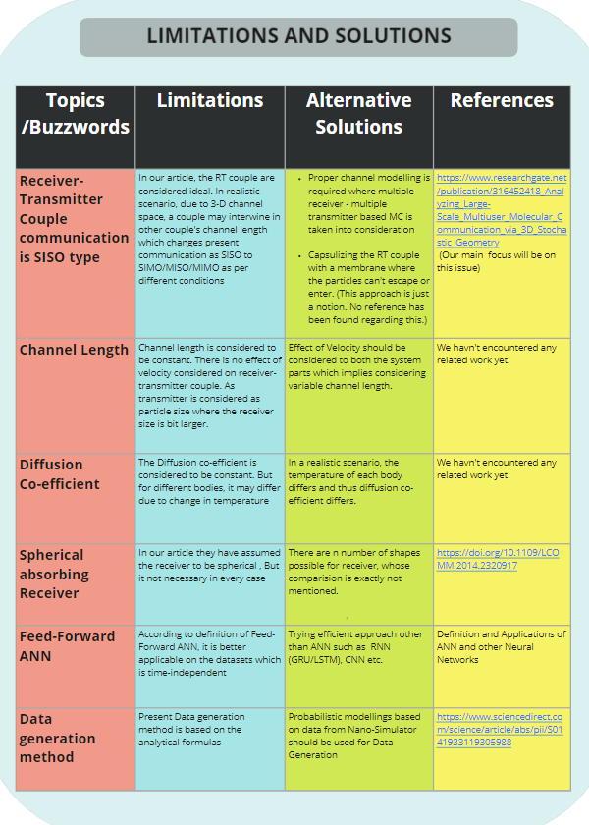
Frame 4 - Part A

Slide 10
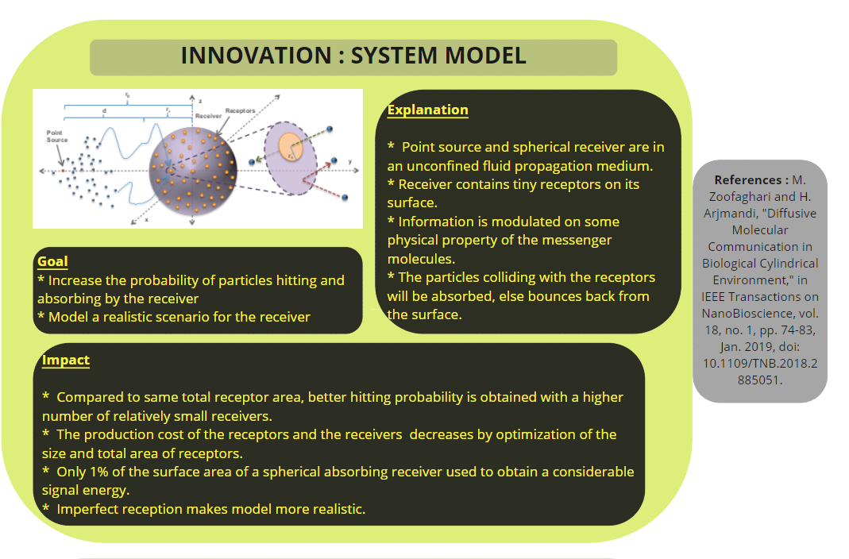
Frame 4 - Part B

Slide 11
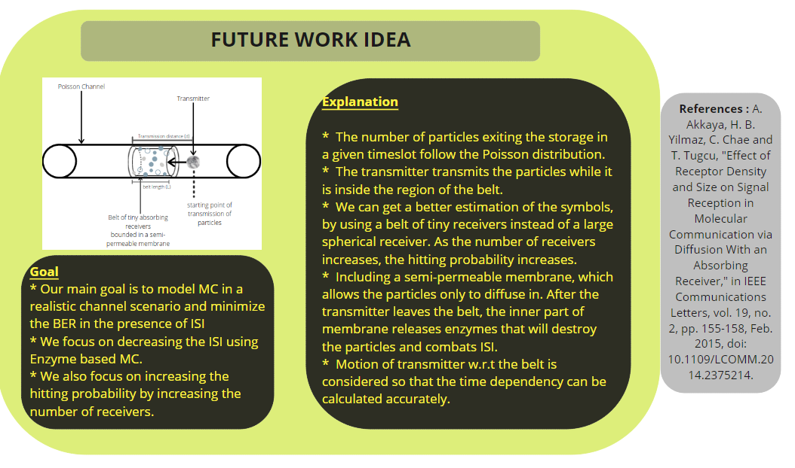
Frame 4 - Part C

Slide 12
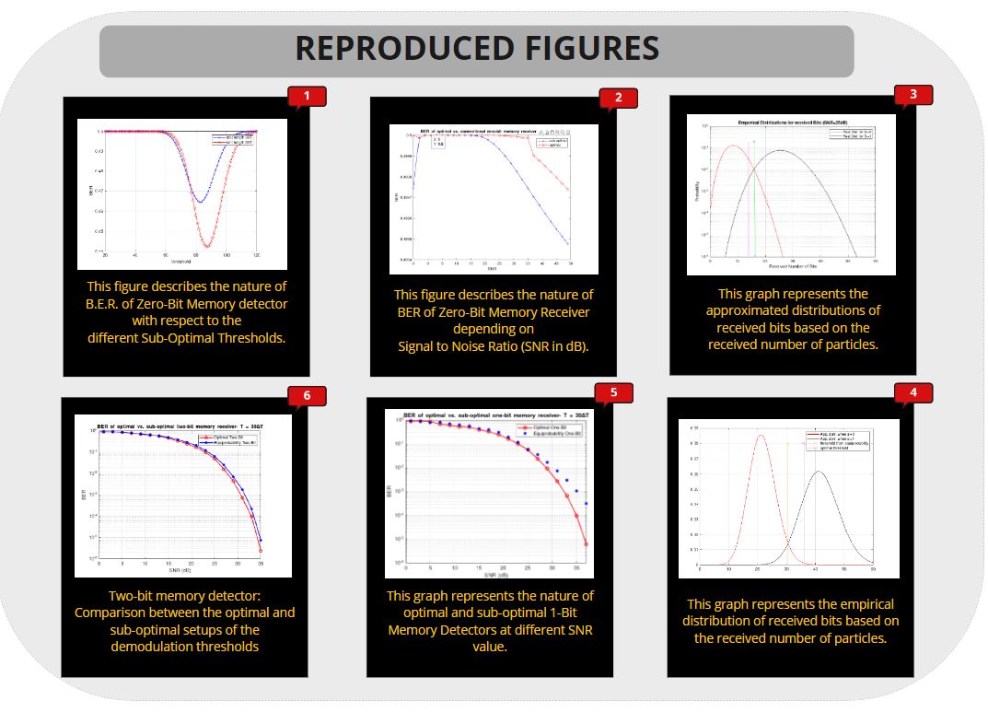
Frame 4 - Part D

Slide 13
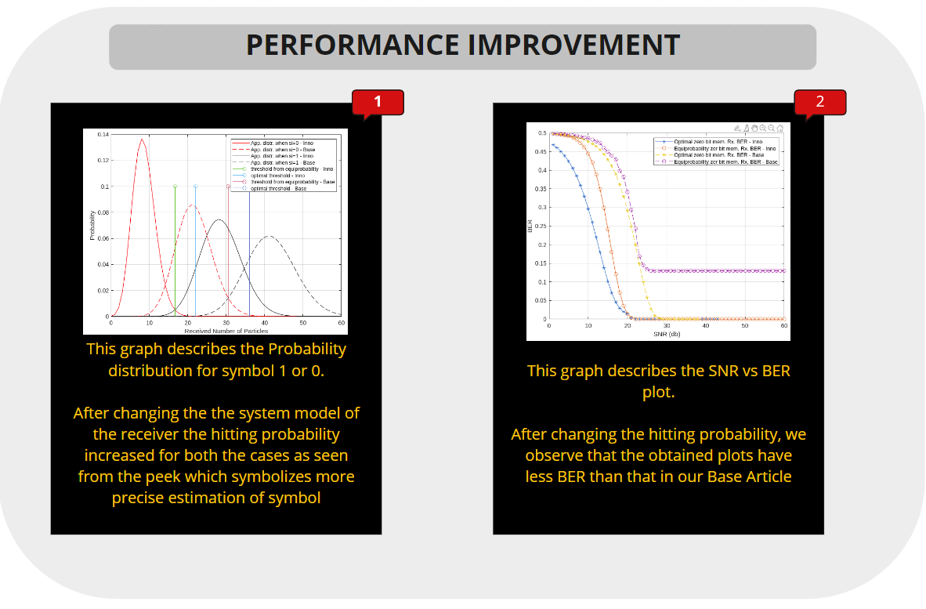
Frame 4 - Part E

Slide 14
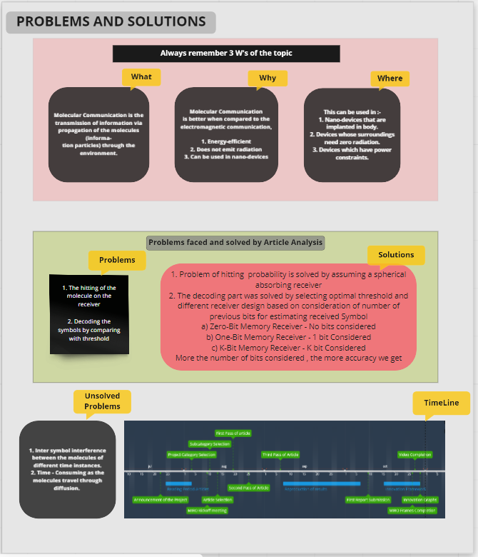
Frame 5 - Whole

Slide 15
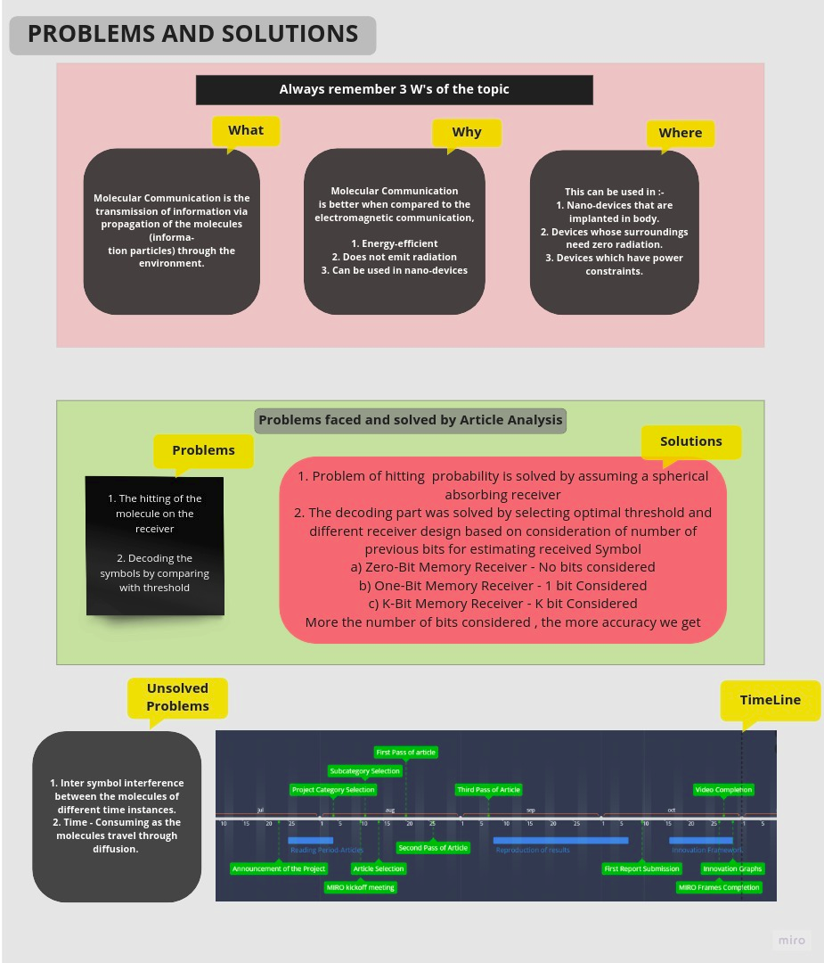
Frame 5 - A

Slide 16
Frame 5 - B

Slide 17
Frame 5 - C

Slide 18
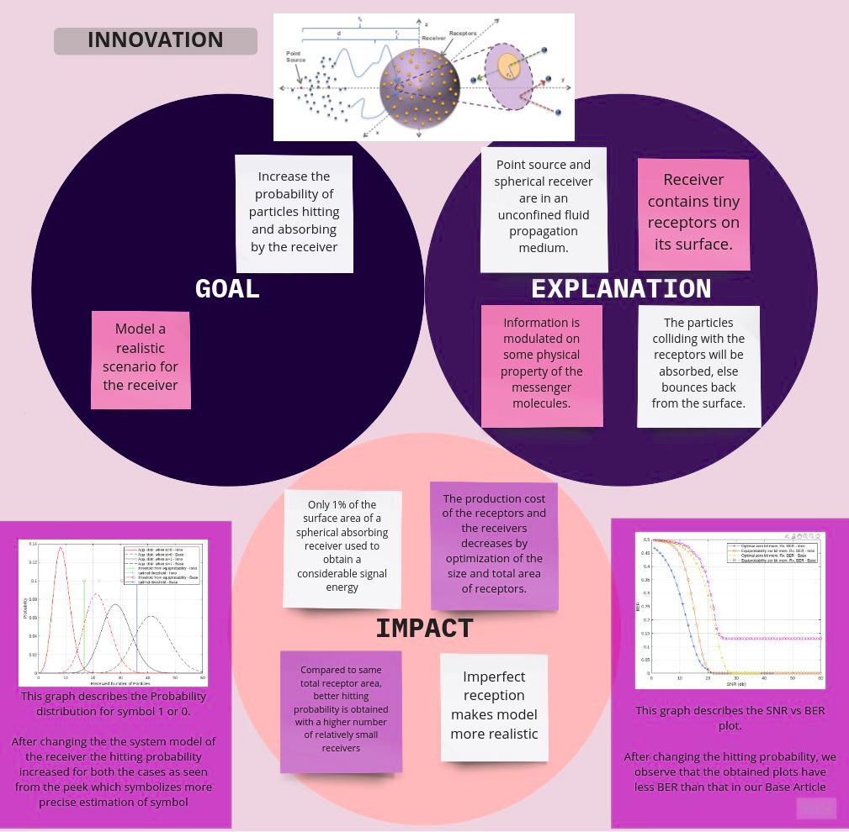
Frame 6 - Whole

Slide 19
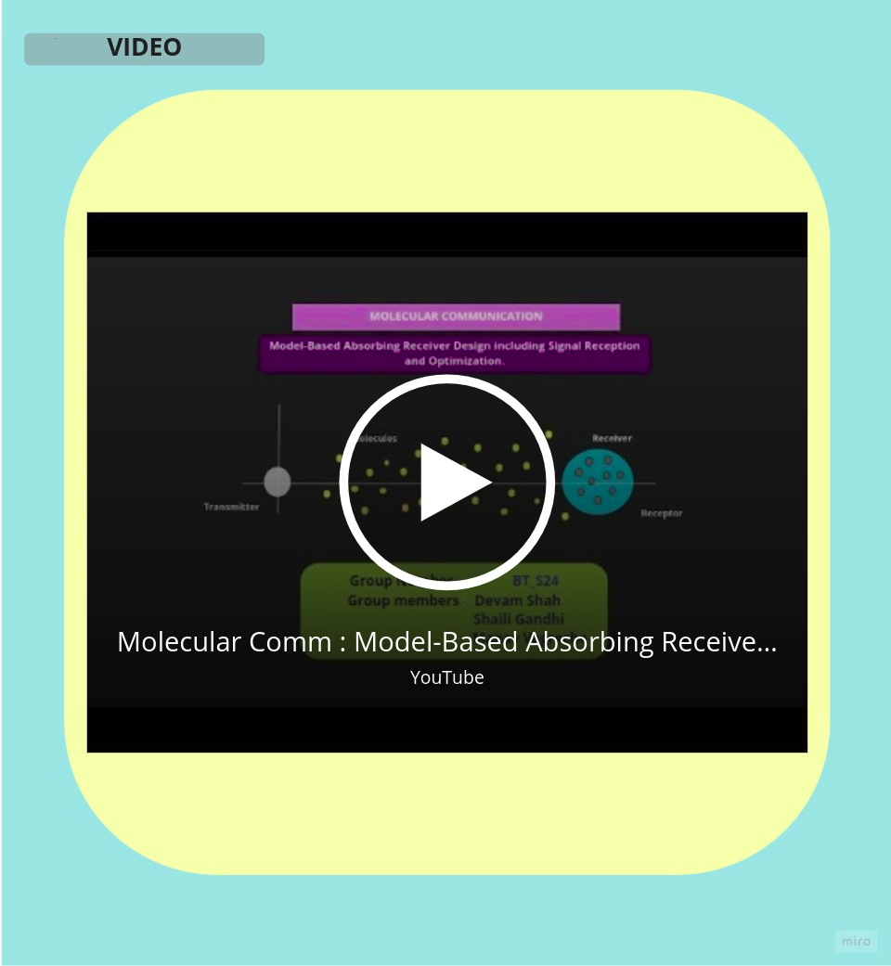
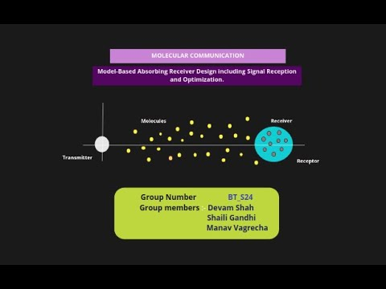
Frame 7 - Whole

